Slide 1
Automatic generation of Face mosaic in news photos
Student | LO King Yuen
Supervisor | LAU Sau Ming

Slide 2
Table of contents
01
02
03
04
Background
Analysis
Technology
Progress

Slide 3

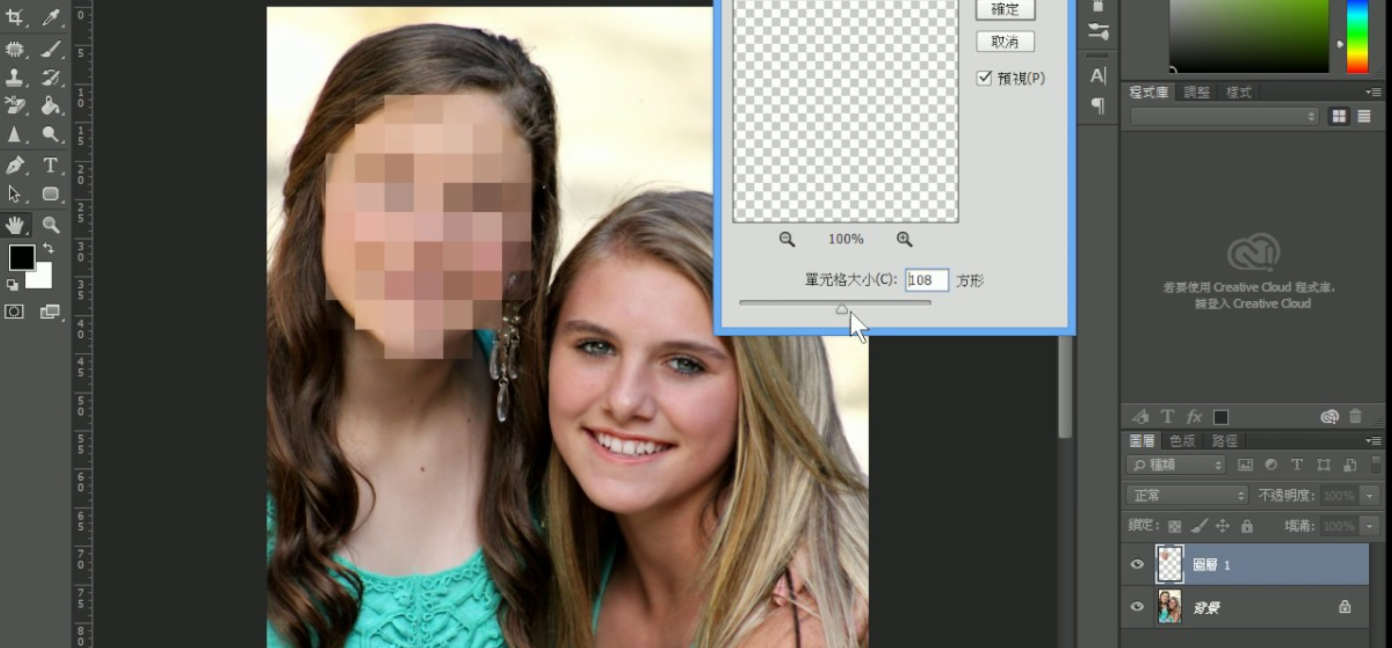

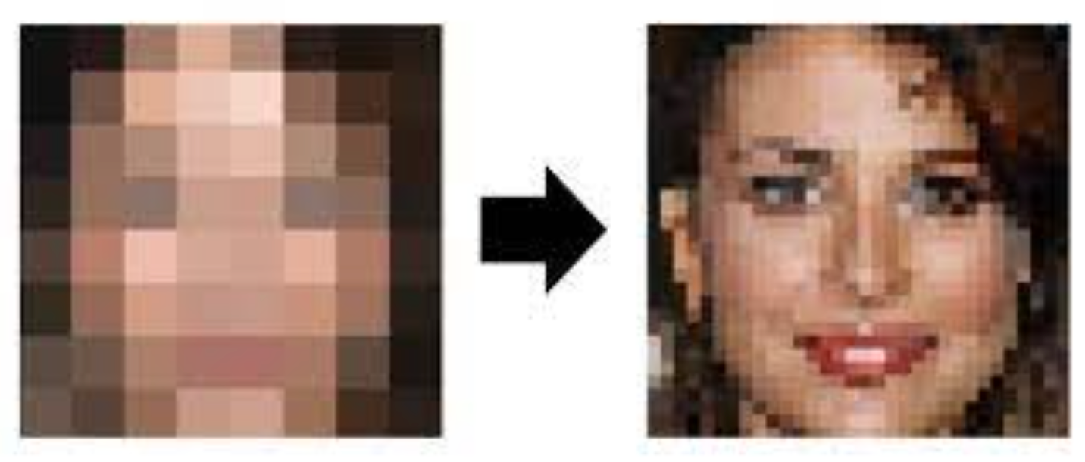
Background
New media industry.
Use Photoshop for setting photo privacy.
Requires some level of expertise.
Process photos quickly, but photoshop has Low efficiency
The privacy level is not high and can be restored by some software.
Too slow
Not secure

Slide 4
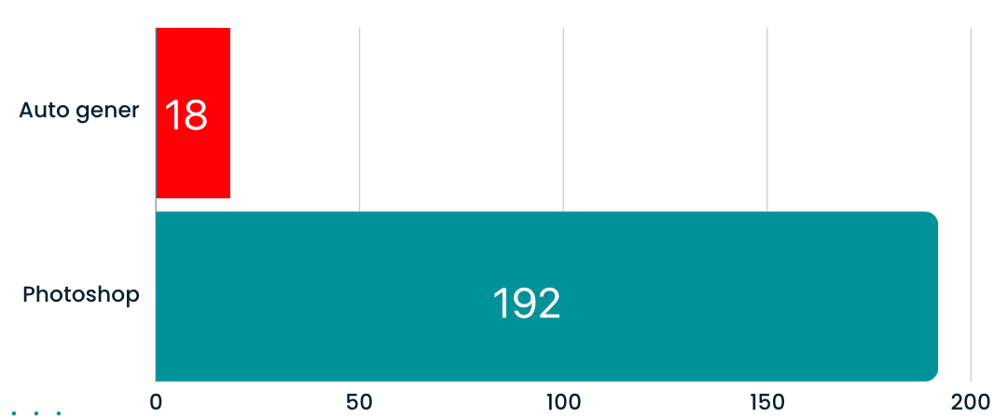
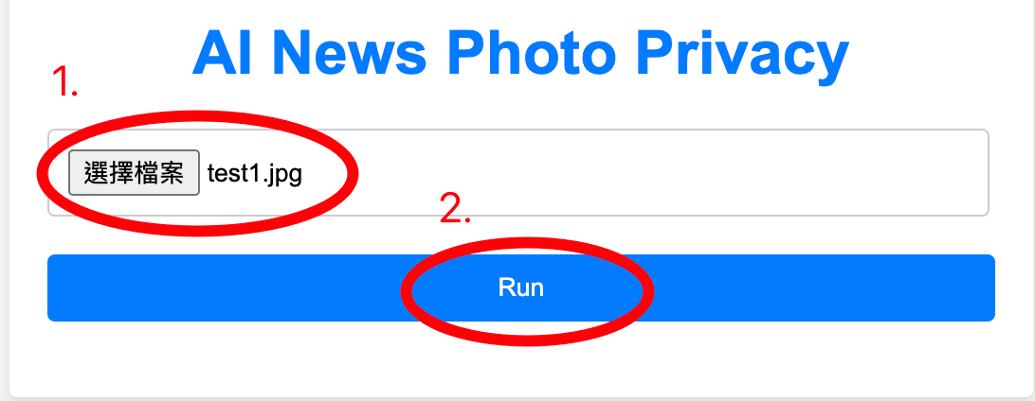
Analysis
/Second
It can save about 90% time by automatically mosaic faces in the news media user.
18
192
Easy to use

Slide 5
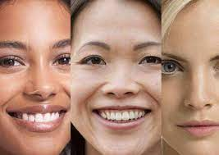

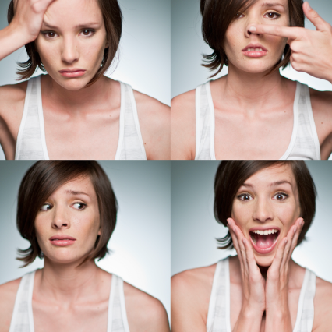
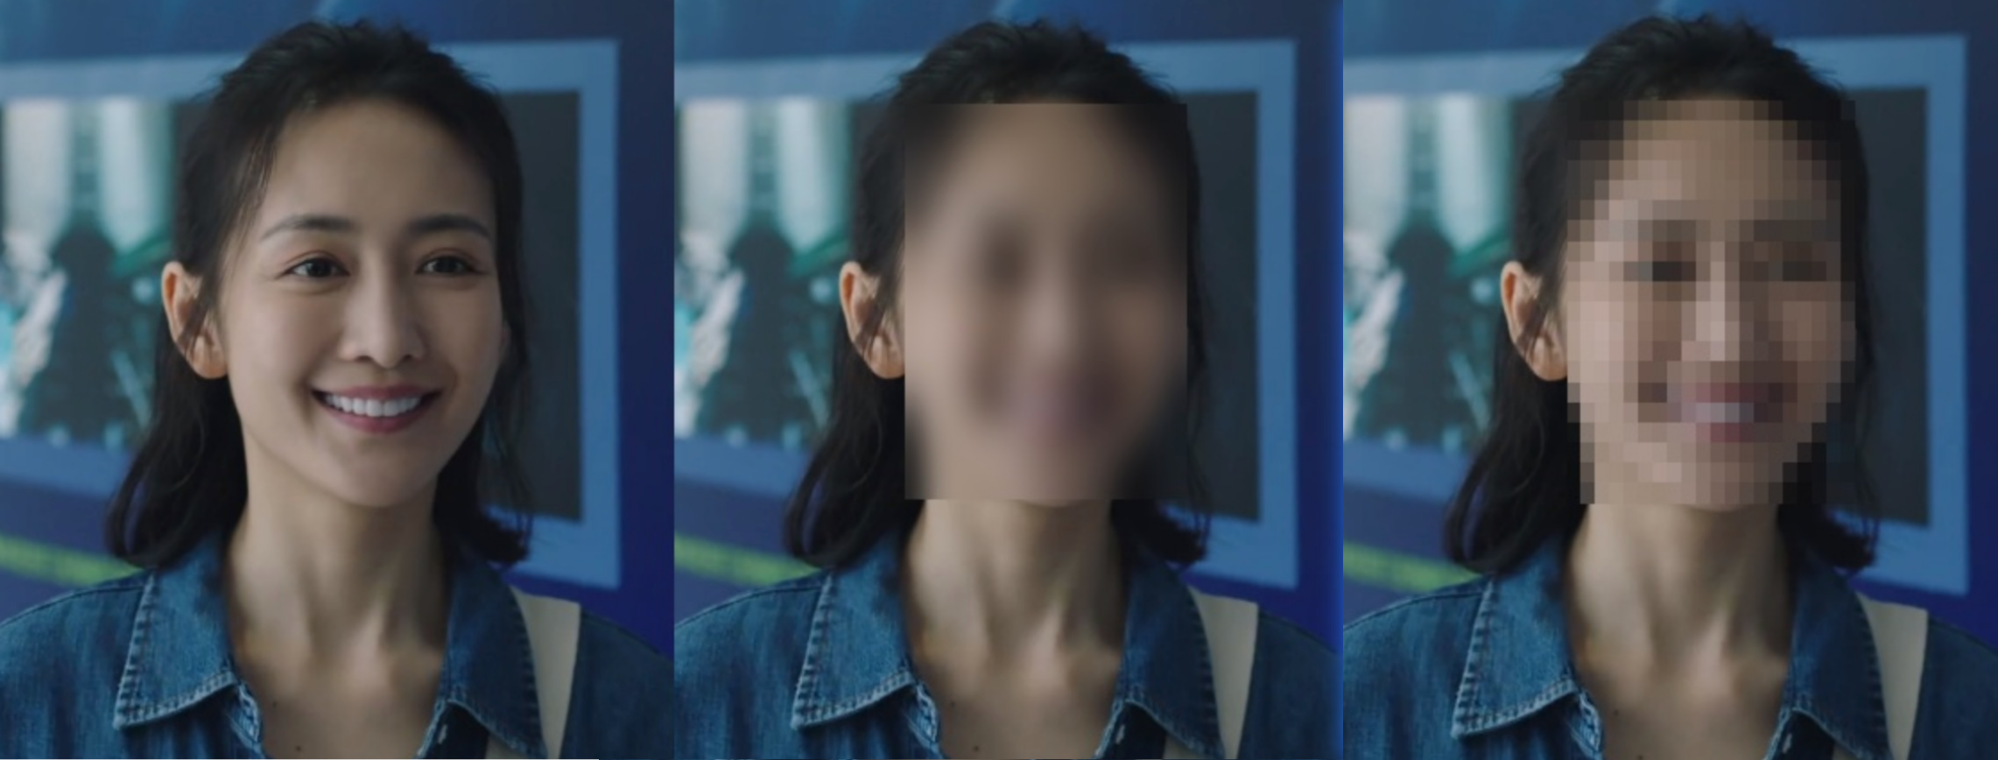
Technology
TensorFlow
Training models using different facial data
OpenCV
GaussianBlur (Mosaic can’t be restored)
Race & Skin color
”models.h2”
Gender
✓
✗
Expressions

Slide 6
Progress
☑ Training models using a facial database and TensorFlow.
☑ OpenCV, using models, can recognize faces.
☑ Applying Gaussian blur using OpenCV.
☐ Processing one photos with multiple faces.
☐ Improving the user interface (UI).

Slide 7
Demo
227206270@stu.vtc.edu.hk
+862 6060 8597
lokingyuen.github.io
Do you have any questions?

